Slide 1
BIEN 401 Biomedical Mass Transport Class 20 Immobilized Enzyme Reactors
notes prepared by
Dr. Louis Reis
Created on 4/28/2022

Slide 2
Immobilized Enzyme Reactors
Extracorporeal devices used to chemically change a species found in the blood.
Normally organs like the liver can breakdown toxic substances (e.g., bilirubin), but patients with damaged or underdeveloped organs need external assistance.
________ are proteins that act as biochemical catalysts with great specificity towards a chemical species.
Most enzymes are named after the substrate whose reaction is catalyzed (e.g., urease, heparinase, etc.) (usually has the suffix _______)

Slide 3
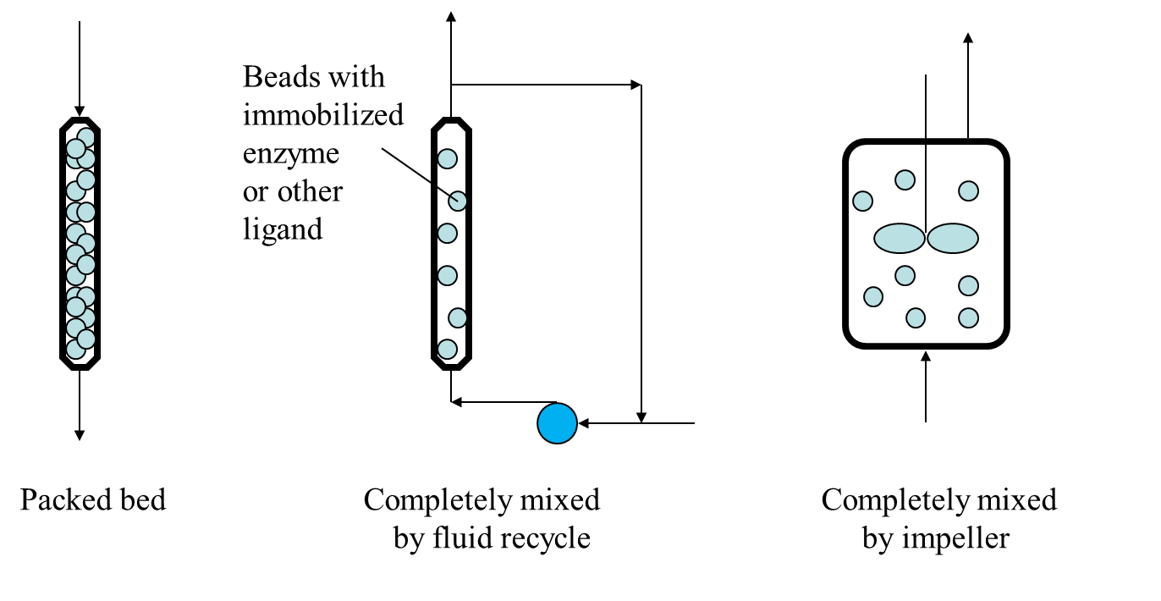
Advantages of Immobilization
The first and foremost important advantage of using immobilized enzymes is that it keeps them out of the blood that is returned to the body. (Recall large proteins are hard to filter out in the kidneys, which means the liver must break down any large proteins.) Allergic reactions can also occur if these proteins return to the body.
Immobilization also allows us to reuse the enzymes (recall a _________ is not used up in a reaction, but enzymes do have a limited lifetime).
Immobilization can help stabilize the enzyme allowing it to retain its activity for a longer period of time.
Each bead is infused with enzyme with a constant number of moles/unit volume throughout.

Slide 4
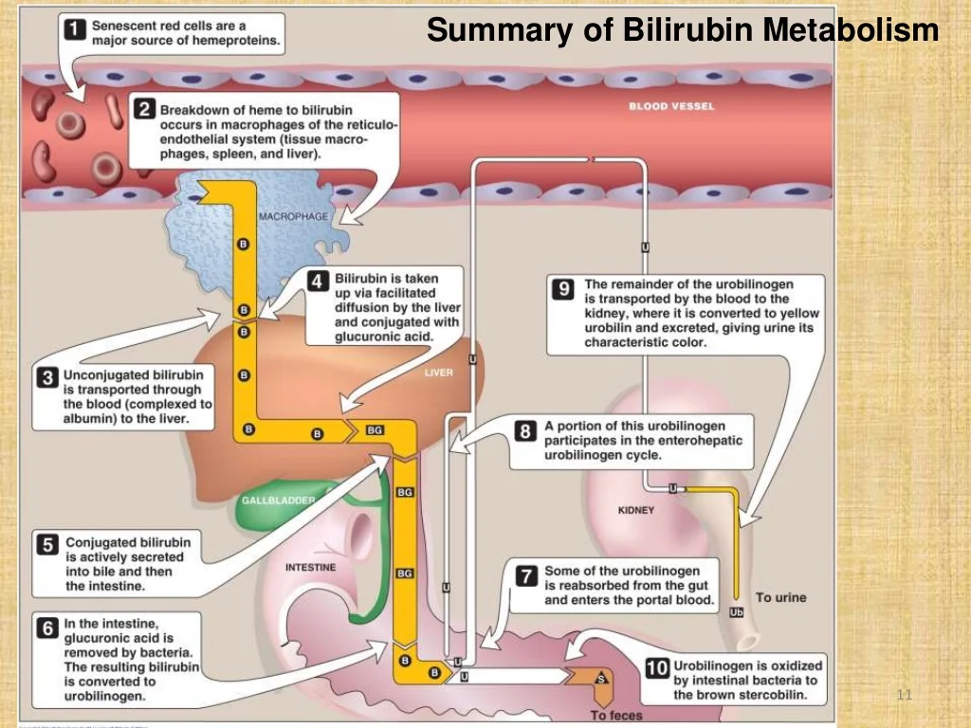
Example Uses of Immobilized Enzyme Reactors
Example 1: Neonatal jaundice
High levels of _________
Normally eliminated in the liver
Neonatal liver is not fully developed
Use of a bilirubin-specific enzyme, bilirubin oxidase as follows
bilirubin + 1/2O₂ → biliverdin + H₂O
Biliverdin is less toxic than bilirubin
It is further converted to less toxic compounds
Conversion to much less toxic compounds
Example 2: Removal of __________ during use of extracorporeal devices

Slide 5
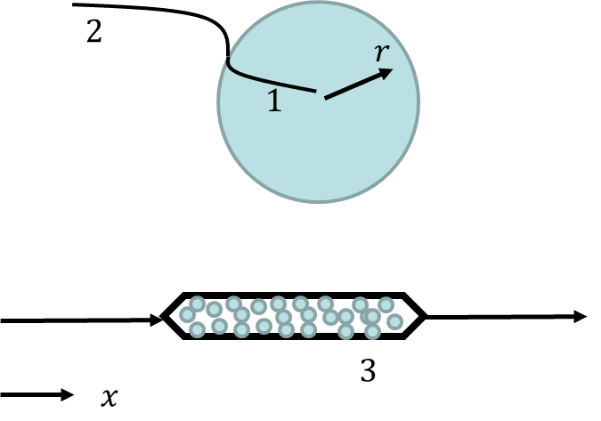
Packed Bed Reactor – steps
We will analyze the packed bed affinity reactor in three parts.
Concentration of substrate as a function of radius within each sphere, assuming that we know the concentration at the sphere surface.
Concentration as a function of radius outside of a single sphere, so that we can find the surface concentration.
Concentration as a function of distance along the packed bed reactor.

Slide 6
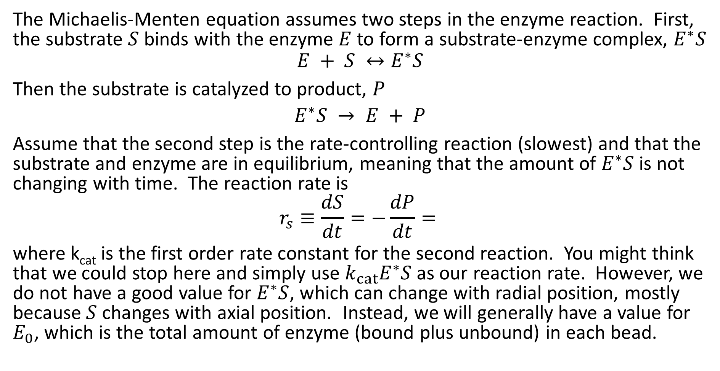
Reaction Kinetics
The Michaelis-Menten equation assumes two steps in the enzyme reaction. First, the substrate $S$ binds with the enzyme $E$ to form a substrate-enzyme complex, $E^{∗}S$
$$E + S ↔E^{∗}S$$
Then the substrate is catalyzed to product, $P$
$$E^{∗}S → E + P$$
Assume that the second step is the rate-controlling reaction (slowest) and that the substrate and enzyme are in equilibrium, meaning that the amount of $E^{∗}S$ is not changing with time. The reaction rate is
$$r_{s}≡\frac{dS}{dt}=−\frac{dP}{dt}=$$
where k_{cat} is the first order rate constant for the second reaction. You might think that we could stop here and simply use $k_{cat}E^{∗}S$ as our reaction rate. However, we do not have a good value for $E^{∗}S$, which can change with radial position, mostly because $S$ changes with axial position. Instead, we will generally have a value for $E_{0}$, which is the total amount of enzyme (bound plus unbound) in each bead.

Slide 7
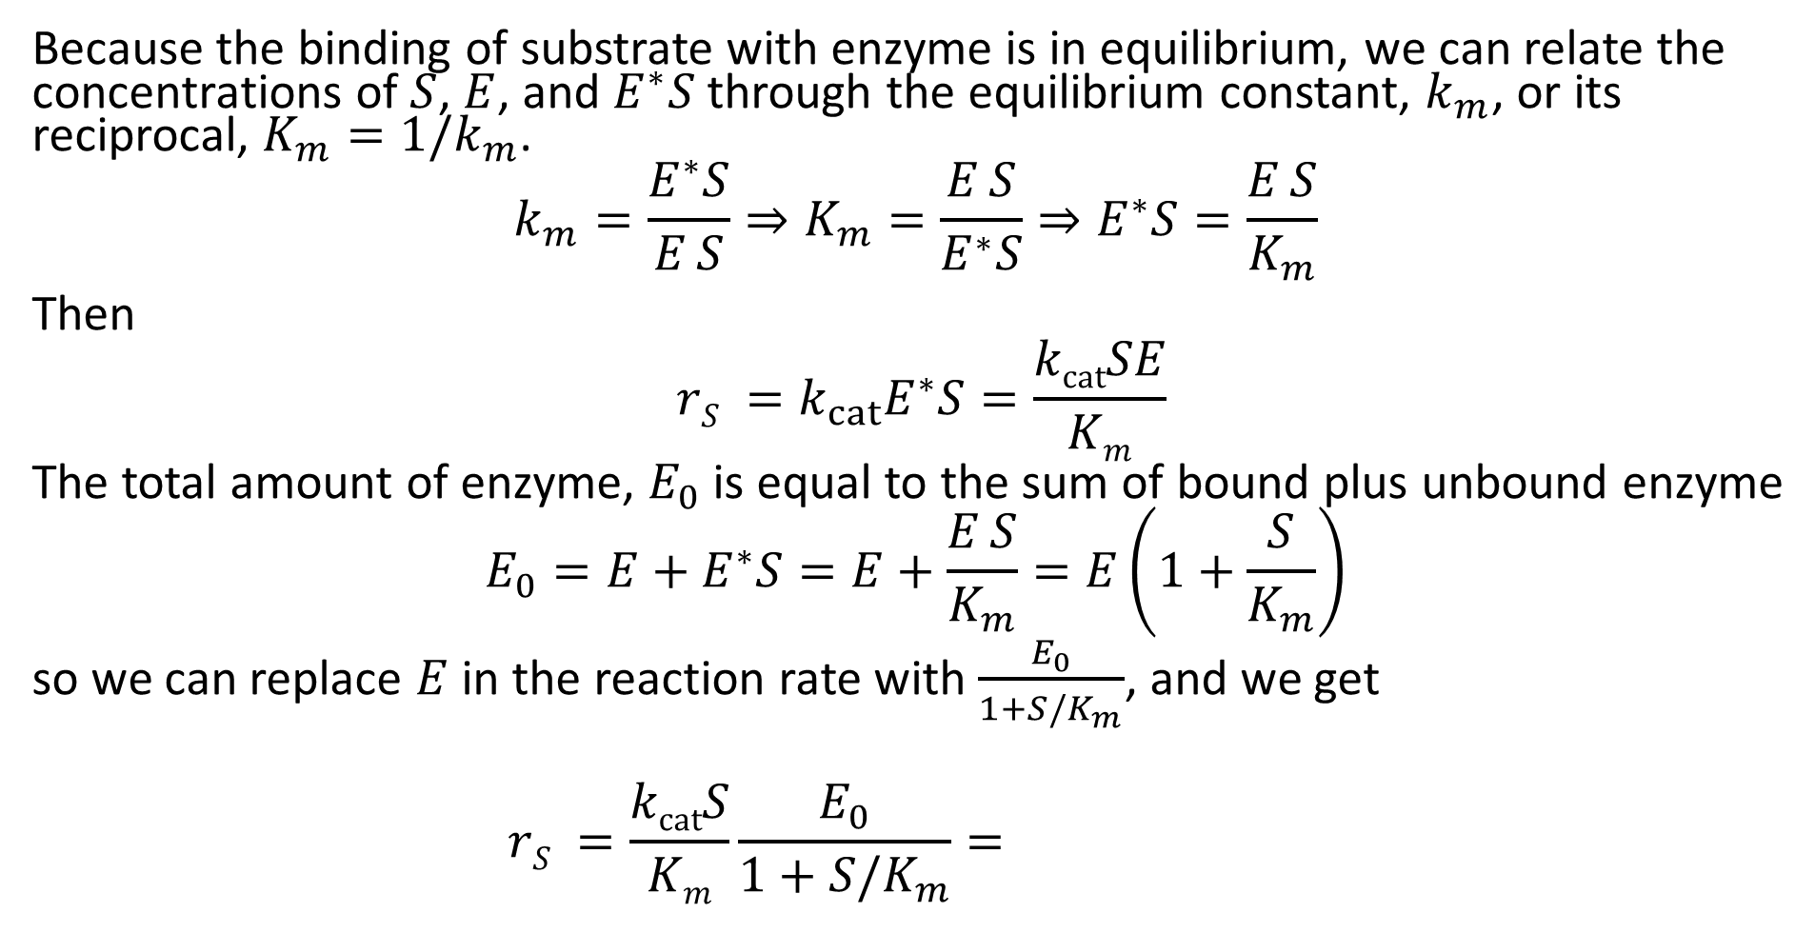
Reaction Kinetics
Because the binding of substrate with enzyme is in equilibrium, we can relate the concentrations of $S$, $E$, and $E^{∗}S$ through the equilibrium constant, $k_{m}$, or its reciprocal, $K_{m}=1/k_{m}$.
$$k_{m}=\frac{E^{∗}S}{E S}⇒K_{m}=\frac{E S}{E^{∗}S}⇒E^{∗}S=\frac{E S}{K_{m}}$$
Then
$$rS =k_{cat}E^{∗}S=\frac{kcatSE}{Km}$$
The total amount of enzyme, $E_{0}$ is equal to the sum of bound plus unbound enzyme
$$E_{0}=E+E^{∗}S=E+\frac{E S}{K_{m}}=E\left(1+\frac{S}{K_{m}}\right)$$
so we can replace $E$ in the reaction rate with $\frac{E_{0}}{1+S/K_{m}}$, and we get
$$rS =\frac{kcatS}{Km}\frac{E_{0}}{1+S/K_{m}}=$$

Slide 8
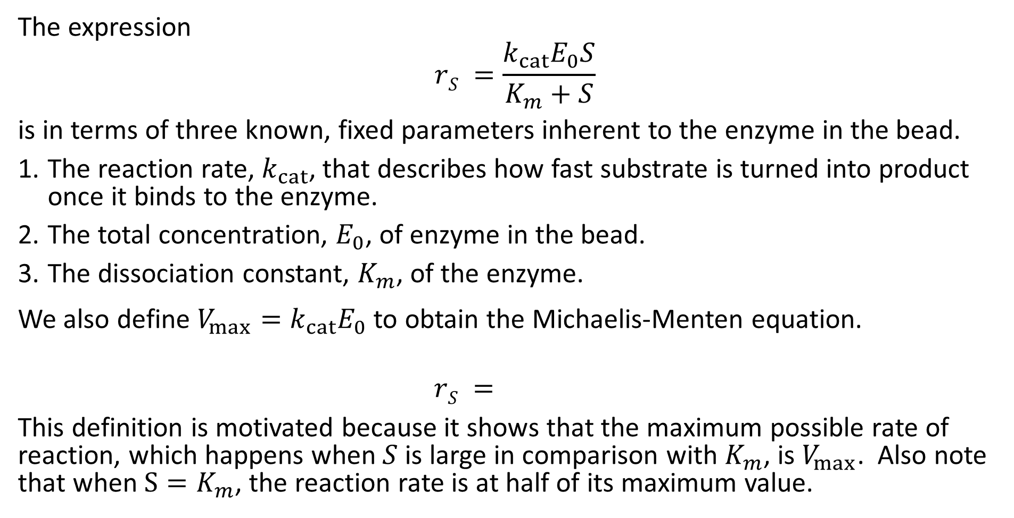
Reaction Kinetics – Immobilized Enzyme Reactors
The expression
$$rS =\frac{k_{cat}E_{0}S}{K_{m}+S}$$
is in terms of three known, fixed parameters inherent to the enzyme in the bead.
The reaction rate, $k_{cat}$, that describes how fast substrate is turned into product once it binds to the enzyme.
The total concentration, $E_{0}$, of enzyme in the bead.
The dissociation constant, $K_{m}$, of the enzyme.
We also define $V_{max}=k_{cat}E_{0}$ to obtain the Michaelis-Menten equation.
$$rS =$$
This definition is motivated because it shows that the maximum possible rate of reaction, which happens when $S$ is large in comparison with $K_{m}$, is $V_{max}$. Also note that when $S=K_{m}$, the reaction rate is at half of its maximum value.

Slide 9
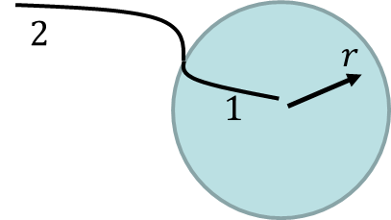

Diffusion Inside the Beads
The medium penetrates the beads through pores (looking at part 1). Consequently, diffusion in the bead is modified as before by steric exclusion (partition coefficient, $K$), wall resistance, $ω_{r}$, porosity, $ε$, and tortuosity, $τ$.

Slide 10
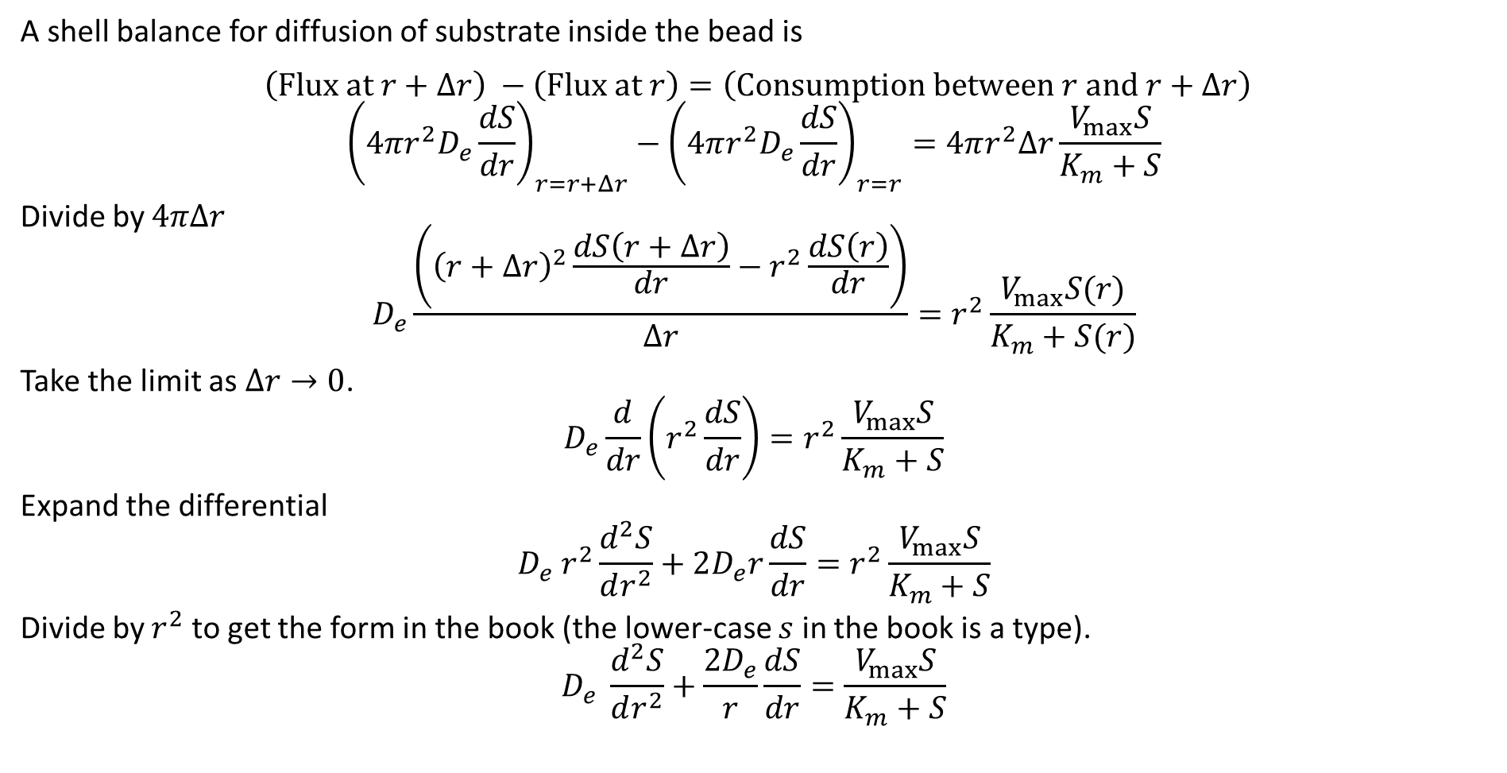
Reaction and Diffusion Inside the Bead
A shell balance for diffusion of substrate inside the bead is
$$\left(Flux at r+Δr\right) −\left(\text{Flux} \text{at} r\right)=\left(\text{Consumption} \text{between} r \text{and} r+Δr\right)$$
$${\left(4πr^{2}D_{e}\frac{dS}{dr}\right)}_{r=r+Δr}−{\left(4πr^{2}D_{e}\frac{dS}{dr}\right)}_{r=r}=4πr^{2}Δr\frac{V_{max}S}{K_{m}+S}$$
Divide by $4πΔr$
$$D_{e}\frac{\left({\left(r+Δr\right)}^{2}\frac{dS\left(r+Δr\right)}{dr}−r^{2}\frac{dS\left(r\right)}{dr}\right)}{Δr}=r^{2}\frac{V_{max}S(r)}{K_{m}+S(r)}$$
Take the limit as $Δr→0$.
$$D_{e}\frac{d}{dr}\left(r^{2}\frac{dS}{dr}\right)=r^{2}\frac{V_{max}S}{K_{m}+S}$$
Expand the differential
$$D_{e} r^{2}\frac{d^{2}S}{dr^{2}}+2D_{e}r\frac{dS}{dr}=r^{2}\frac{V_{max}S}{K_{m}+S}$$
Divide by $r^{2}$ to get the form in the book (the lower-case $s$ in the book is a type).
$$D_{e} \frac{d^{2}S}{dr^{2}}+\frac{2D_{e}}{r}\frac{dS}{dr}=\frac{V_{max}S}{K_{m}+S}$$
Note: we could have also used the general mass balance equation (for spherical coordinates).

Slide 11
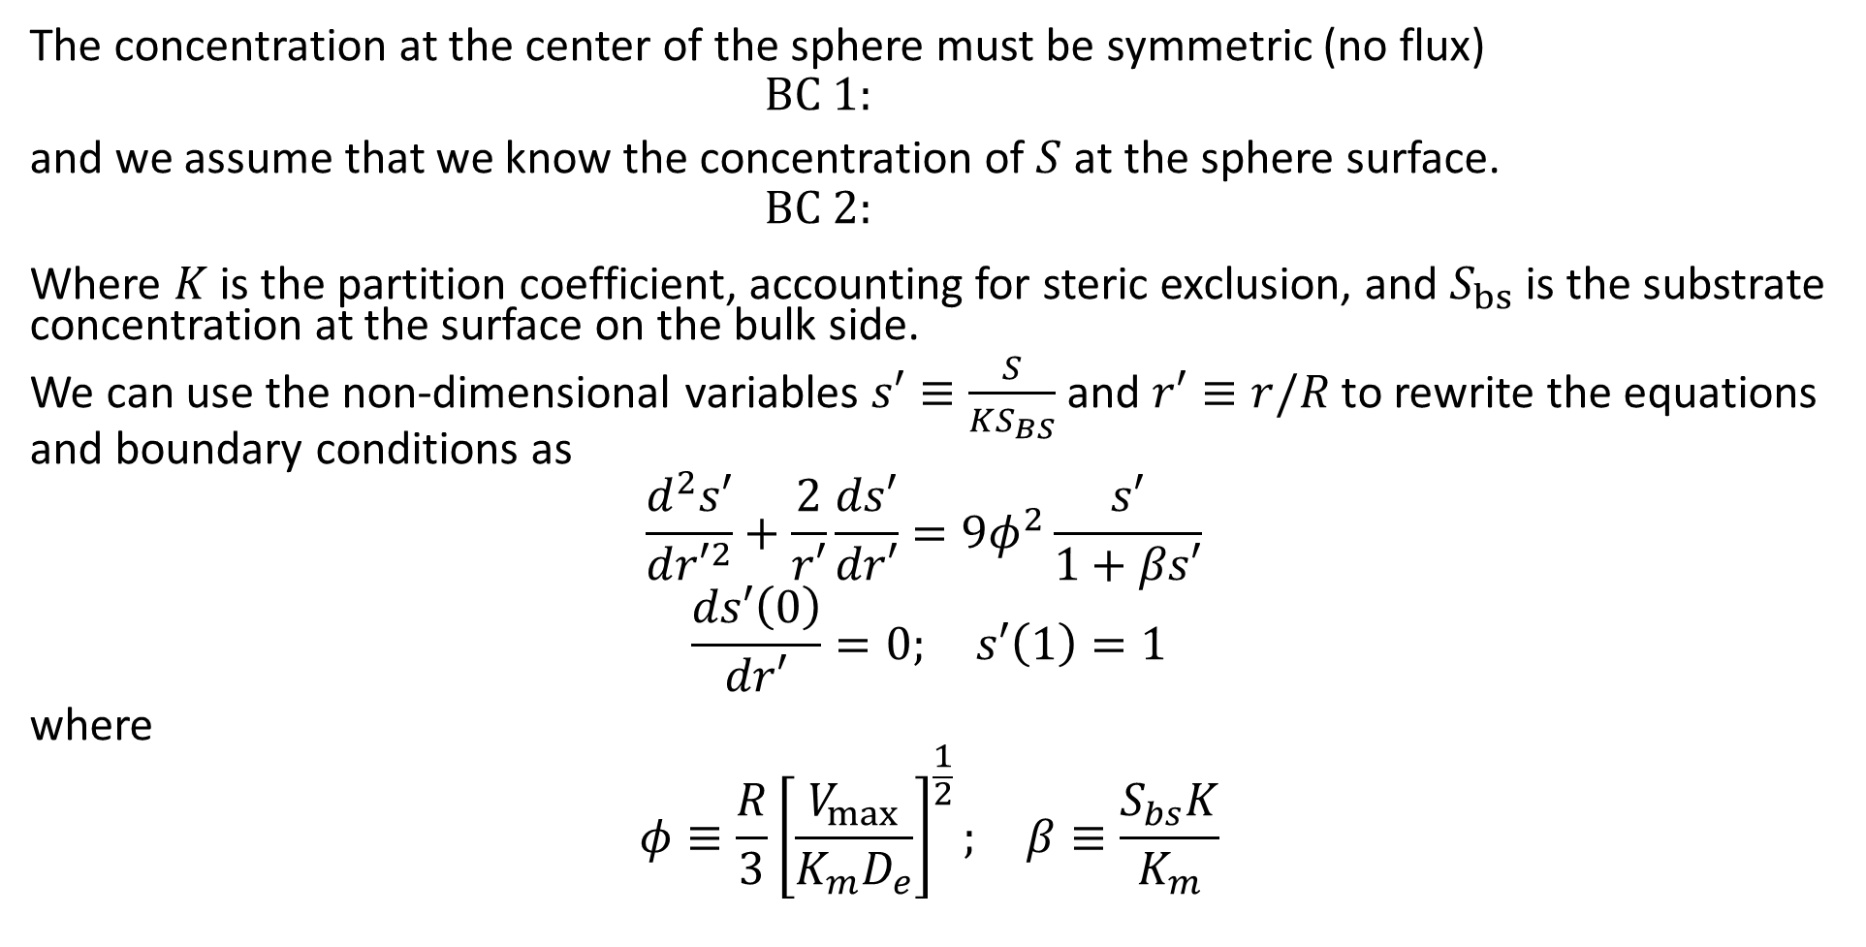
Reaction and Diffusion Inside the Bead
The concentration at the center of the sphere must be symmetric (no flux)
$$BC 1:$$
and we assume that we know the concentration of $S$ at the sphere surface.
$$\text{BC} \text{2:}$$
Where $K$ is the partition coefficient, accounting for steric exclusion, and $S_{bs}$ is the substrate concentration at the surface on the bulk side.
We can use the non-dimensional variables $s′≡\frac{S}{KS_{BS}}$ and $r′≡r/R$ to rewrite the equations and boundary conditions as
$$\frac{d^{2}s′}{d{r′}^{2}}+\frac{2}{r′}\frac{ds′}{dr′}=9φ^{2}\frac{s′}{1+βs′}$$
$$\frac{ds′\left(0\right)}{dr′}=0; s′\left(1\right)=1$$
where
$$φ≡\frac{R}{3}{\left[\frac{V_{max}}{K_{m}D_{e}}\right]}^{\frac{1}{2}}; β≡\frac{S_{bs}K}{K_{m}}$$

Slide 12
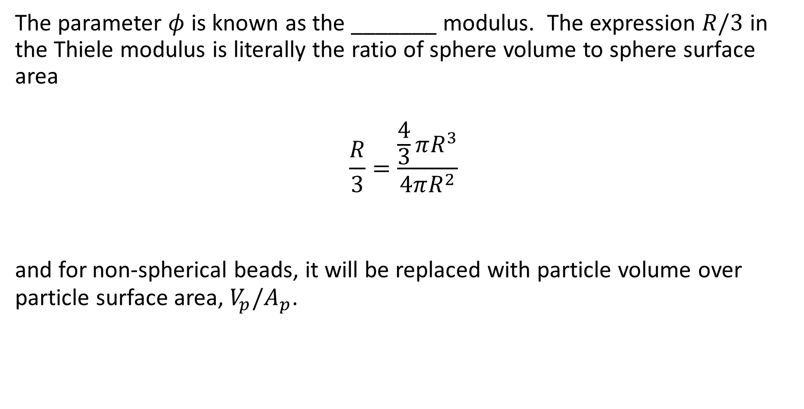
Thiele Modulus
The parameter $φ$ is known as the _______ modulus. The expression $R/3$ in the Thiele modulus is literally the ratio of sphere volume to sphere surface area
$$\frac{R}{3}=\frac{\frac{4}{3}πR^{3}}{4πR^{2}}$$
and for non-spherical beads, it will be replaced with particle volume over particle surface area, $V_{p}/A_{p}$.

Slide 13
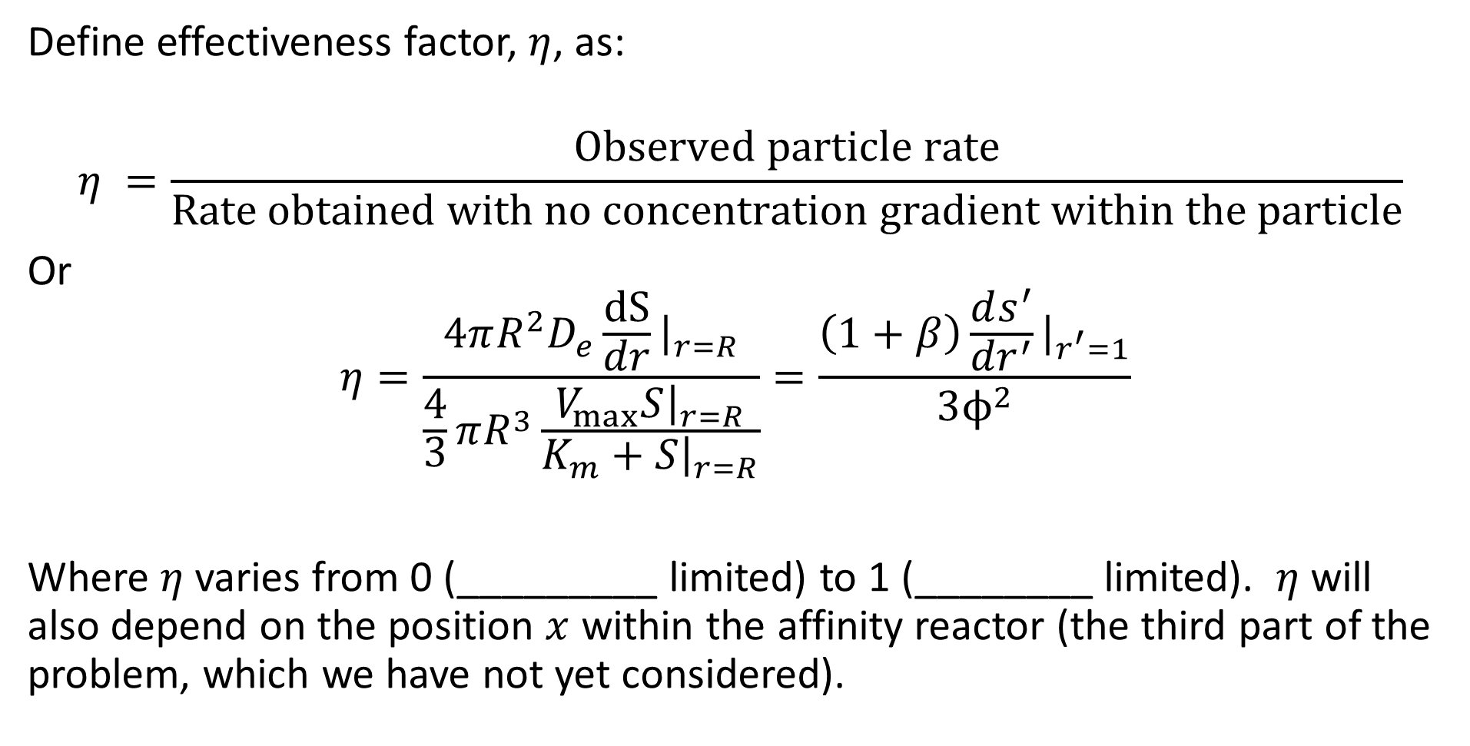
Effectiveness Factor
Define effectiveness factor, $η$, as:
$$η =\frac{\text{Observed} \text{particle} \text{rate}}{\text{Rate} \text{obtained} \text{with} \text{no} \text{concentration} \text{gradient} \text{within} \text{the} \text{particle}}$$
Or
$$η=\frac{4πR^{2}D_{e}\frac{dS}{dr}{\left.​\right|}_{r=R}}{\frac{4}{3}πR^{3}\frac{V_{max}S{\left.​\right|}_{r=R}}{K_{m}+S{\left.​\right|}_{r=R}}}=\frac{\left(1+β\right)\frac{ds^{′}}{{dr}^{′}}{\left.​\right|}_{r^{′}=1}}{3ϕ^{2}}$$
Where $η$ varies from 0 (_________ limited) to 1 (________ limited). $η$ will also depend on the position $x$ within the affinity reactor (the third part of the problem, which we have not yet considered).

Slide 14
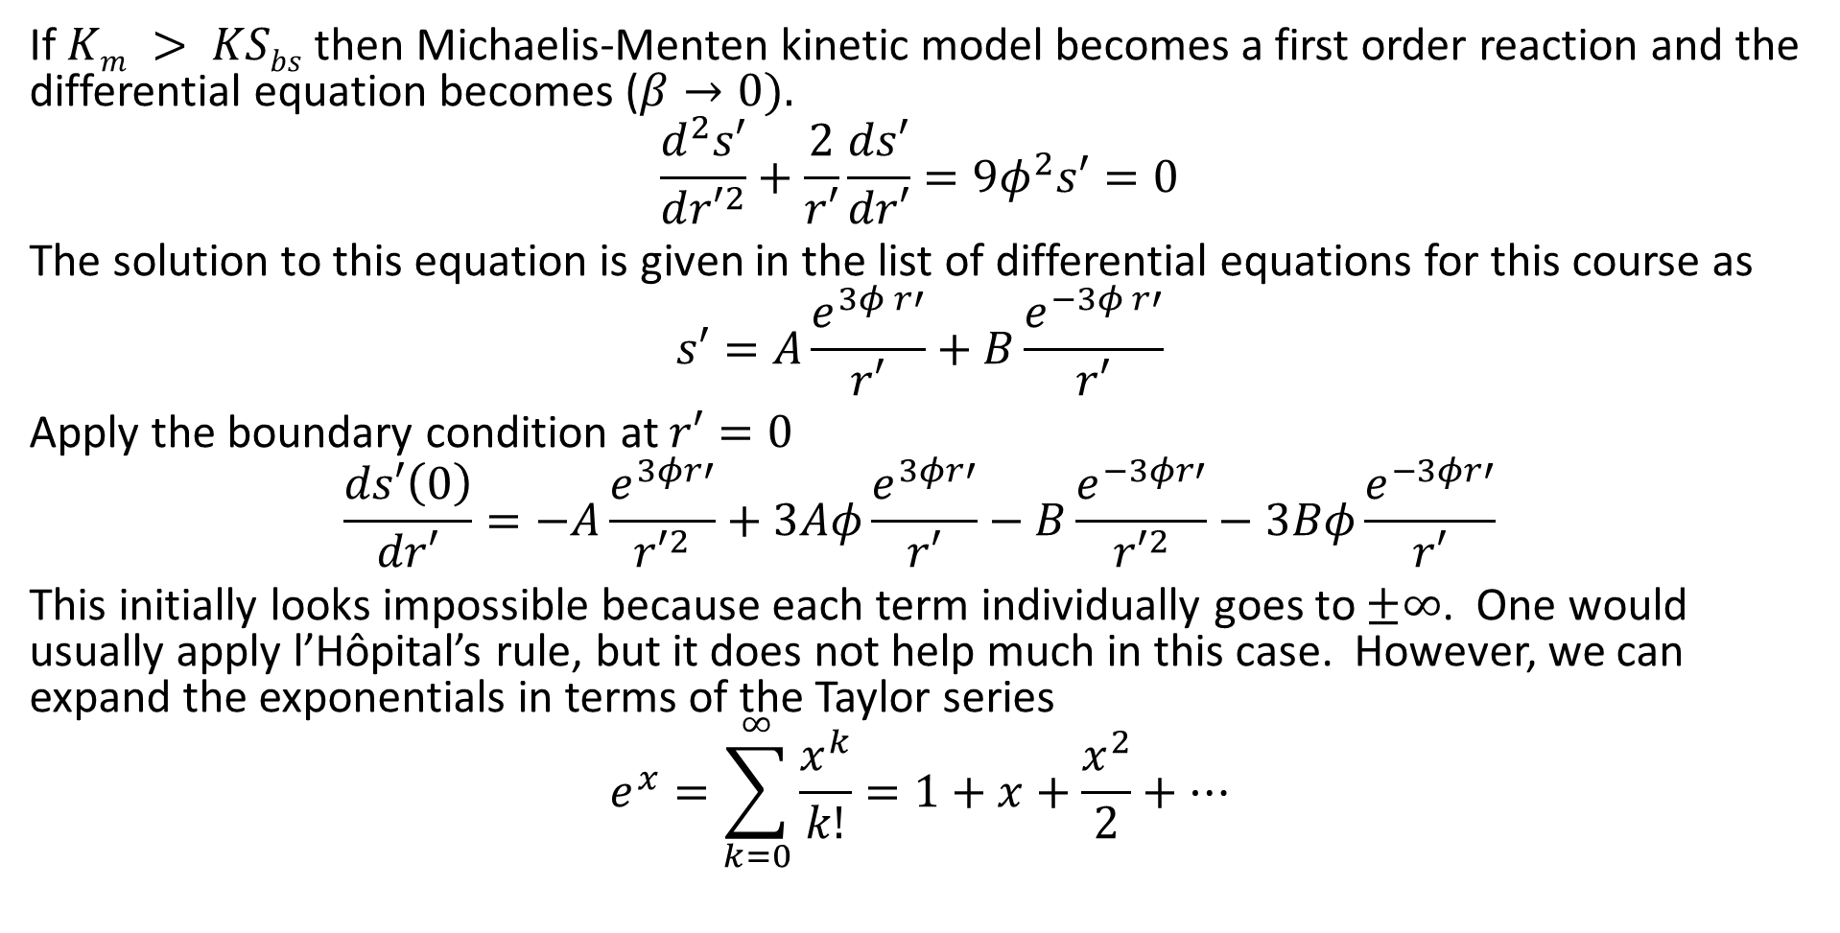
Special Case – First Order Reaction
If $Km > KSbs$ then Michaelis-Menten kinetic model becomes a first order reaction and the differential equation becomes ($β→0).$
$$\frac{d^{2}s′}{d{r′}^{2}}+\frac{2}{r′}\frac{ds′}{dr′}=9φ^{2}s′=0$$
The solution to this equation is given in the list of differential equations for this course as
$$s′=A\frac{e^{3φ r′}}{r′}+B\frac{e^{−3φ r′}}{r′}$$
Apply the boundary condition at $r′=0$
$$\frac{ds′\left(0\right)}{dr′}=−A\frac{e^{3φr′}}{{r′}^{2}}+3Aφ\frac{e^{3φr′}}{r′}−B\frac{e^{−3φr′}}{{r′}^{2}}−3Bφ\frac{e^{−3φr′}}{r′}$$
This initially looks impossible because each term individually goes to $±∞$. One would usually apply l’Hôpital’s rule, but it does not help much in this case. However, we can expand the exponentials in terms of the Taylor series
$$e^{x}=\sum_{k=0}^{∞}{\frac{x^{k}}{k!}}=1+x+\frac{x^{2}}{2}+⋯$$

Slide 15
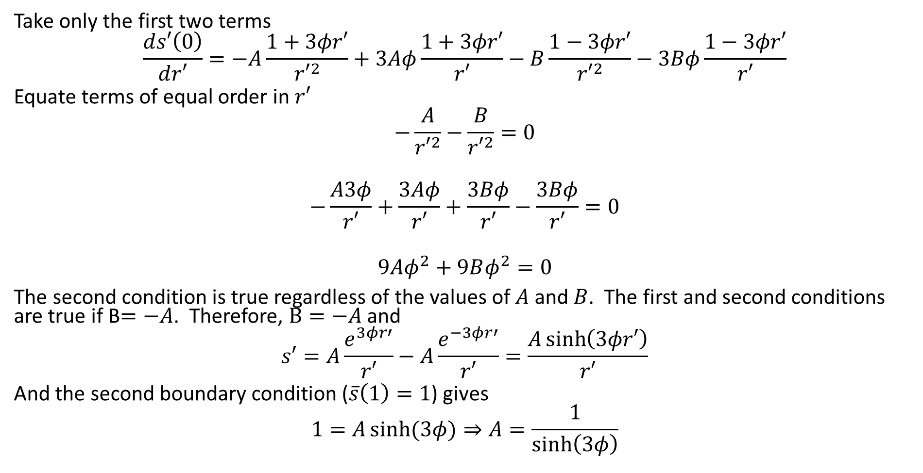
Special Case – First Order Reaction
Take only the first two terms
$$\frac{ds′\left(0\right)}{dr′}=−A\frac{1+3φr′}{{r′}^{2}}+3Aφ\frac{1+3φr′}{r′}−B\frac{1−3φr′}{{r′}^{2}}−3Bφ\frac{1−3φr′}{r′}$$
Equate terms of equal order in $r′$
$$−\frac{A}{{r′}^{2}}−\frac{B}{{r′}^{2}}=0$$
$$−\frac{A3φ}{r′}+\frac{3Aφ}{r′}+\frac{3Bφ}{r′}−\frac{3Bφ}{r′}=0$$
$$9Aφ^{2}+9Bφ^{2}=0$$
The second condition is true regardless of the values of $A$ and $B$. The first and second conditions are true if B$=−A$. Therefore, $B=−A$ and
$$s′=A\frac{e^{3φr′}}{r′}−A\frac{e^{−3φr′}}{r′}=\frac{A\sinh\left(3φr′\right)}{r′}$$
And the second boundary condition ($\overline{s}\left(1\right)=1$) gives
$$1=A\sinh{(3φ)}⇒A=\frac{1}{\sinh\left(3φ\right)}$$

Slide 16
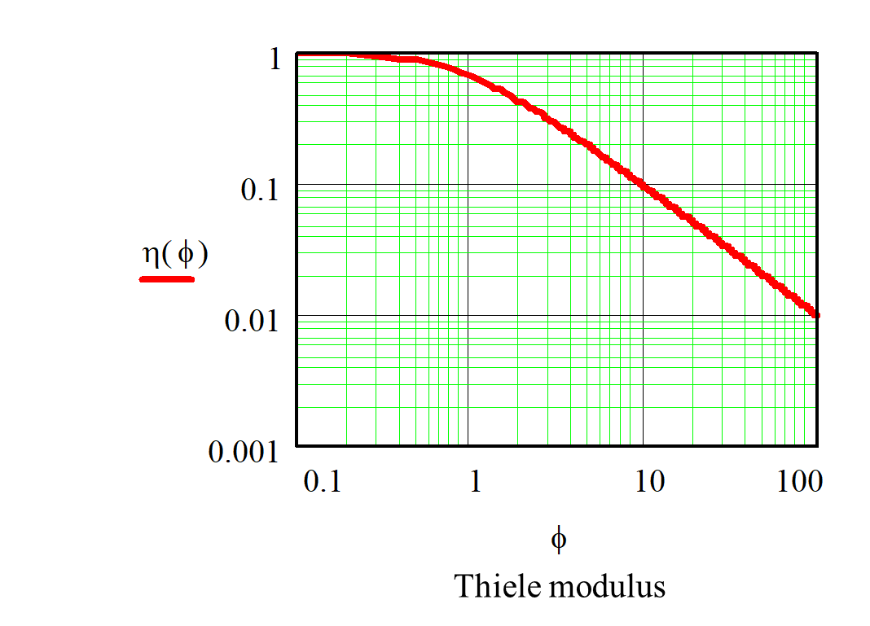
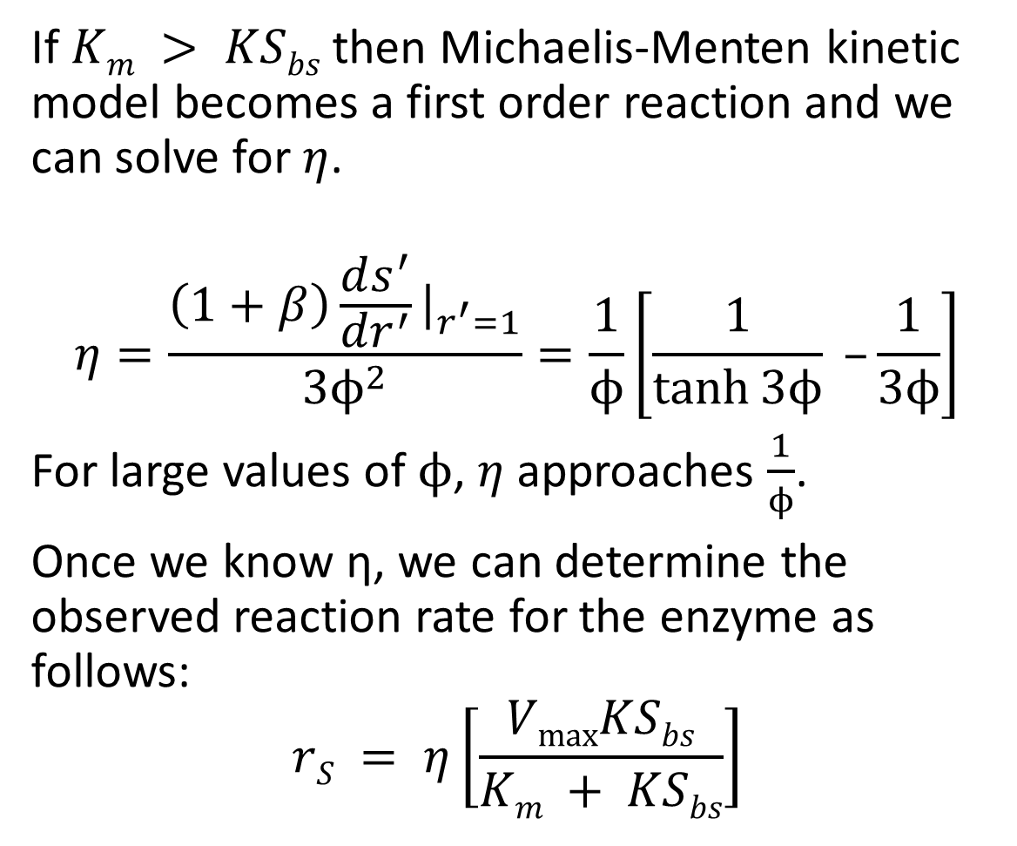
Special Case – First Order Reaction
If $Km > KSbs$ then Michaelis-Menten kinetic model becomes a first order reaction and we can solve for $η$.
$$η=\frac{\left(1+β\right)\frac{ds^{′}}{{dr}^{′}}{\left.​\right|}_{r^{′}=1}}{3ϕ^{2}}=\frac{1}{ϕ}\left[\frac{1}{\tanh{3ϕ}} –\frac{1}{3ϕ}\right]$$
For large values of $ϕ$, $η$ approaches $\frac{1}{ϕ}$.
Once we know η, we can determine the observed reaction rate for the enzyme as follows:
$$rS = η\left[\frac{VmaxKSbs}{Km + KSbs}\right]$$

Slide 17
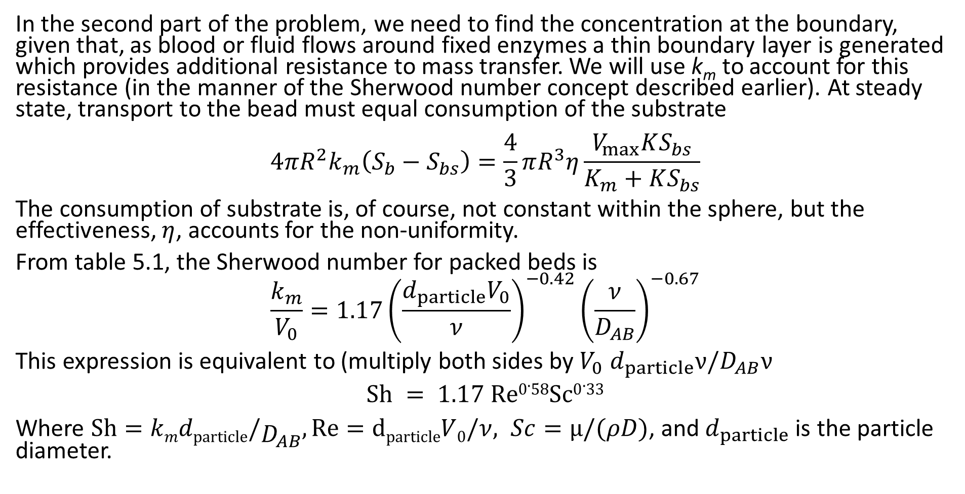
External Mass Transfer resistance
In the second part of the problem, we need to find the concentration at the boundary, given that, as blood or fluid flows around fixed enzymes a thin boundary layer is generated which provides additional resistance to mass transfer. We will use k_{m} to account for this resistance (in the manner of the Sherwood number concept described earlier). At steady state, transport to the bead must equal consumption of the substrate
$$4πR^{2}k_{m}\left(S_{b}−S_{bs}\right)=\frac{4}{3}πR^{3}η\frac{V_{max}KS_{bs}}{K_{m}+KS_{bs}}$$
The consumption of substrate is, of course, not constant within the sphere, but the effectiveness, $η$, accounts for the non-uniformity.
From table 5.1, the Sherwood number for packed beds is
$$\frac{k_{m}}{V_{0}}=1.17{\left(\frac{d_{particle}V_{0}}{ν}\right)}^{−0.42}{\left(\frac{ν}{D_{AB}}\right)}^{−0.67}$$
This expression is equivalent to (multiply both sides by $V_{0}$ $d_{particle}ν/D_{AB}ν$
$$Sh = 1.17 Re0.58Sc0.33$$
Where $\text{Sh}=kmdparticle/D_{AB}, \text{Re}=dparticleV0/ν, Sc=µ/(ρD)$, and $d_{particle}$ is the particle diameter.

Slide 18
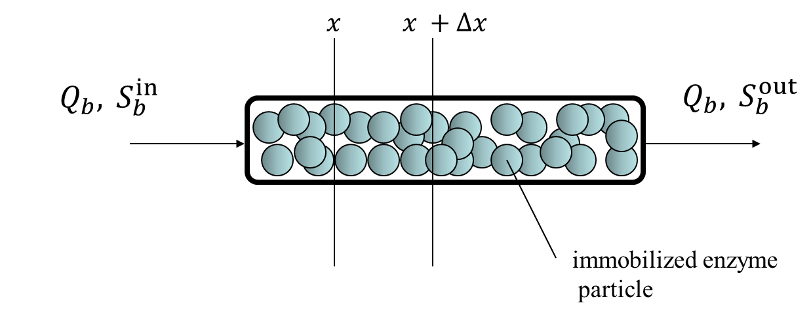
Packed Bed Reactor
The third part of the problem is to determine how the bulk concentration of substrate changes along the reactor. This analysis will depend on the specific reactor geometry, so we will assume a packed bed reactor as pictured at the beginning of this problem.

Slide 19
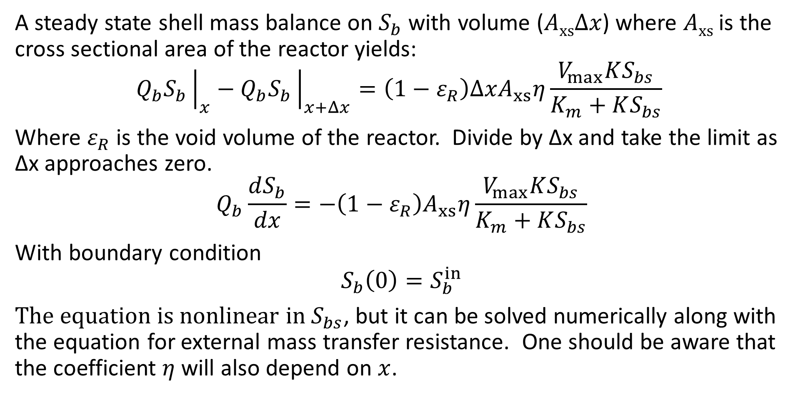
Packed Bed Reactor
A steady state shell mass balance on $S_{b}$ with volume ($AxsΔx$) where $Axs$ is the cross sectional area of the reactor yields:
$$Q_{b}S_{b}{\left.​\right|}_{x}−Q_{b}S_{b}{\left.​\right|}_{x+Δx}=\left(1−ε_{R}\right)ΔxA_{xs}η\frac{V_{max}KS_{bs}}{K_{m}+KS_{bs}}$$
Where $ε_{R}$ is the void volume of the reactor. Divide by Δx and take the limit as Δx approaches zero.
$$Q_{b}\frac{dS_{b}}{dx}=−\left(1−ε_{R}\right)A_{xs}η\frac{V_{max}KS_{bs}}{K_{m}+KS_{bs}}$$
With boundary condition
$$S_{b}\left(0\right)=S_{b}^{in}$$
The equation is nonlinear in $S_{bs}$, but it can be solved numerically along with the equation for external mass transfer resistance. One should be aware that the coefficient $η$ will also depend on $x$.

Slide 20
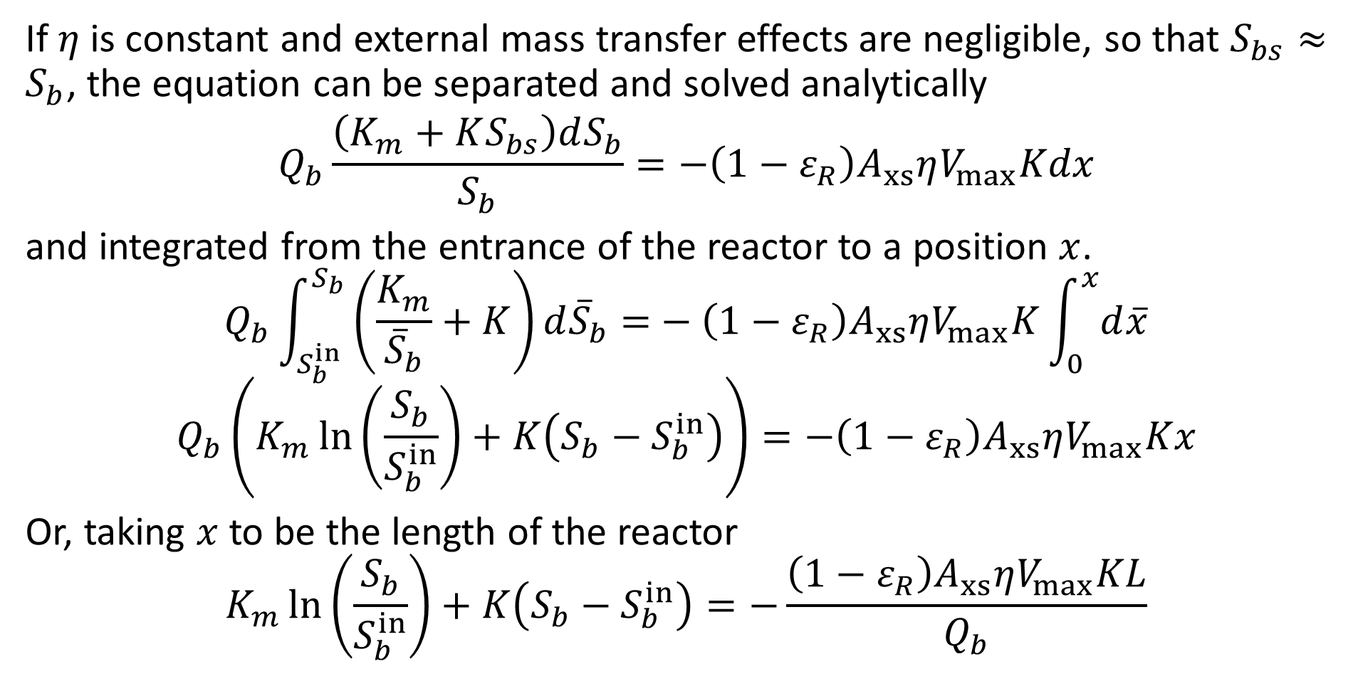
Packed Bed Reactor
If $η$ is constant and external mass transfer effects are negligible, so that $S_{bs}≈S_{b}$, the equation can be separated and solved analytically
$$Q_{b}\frac{\left(K_{m}+KS_{bs}\right)dS_{b}}{S_{b}}=−\left(1−ε_{R}\right)A_{xs}ηV_{max}Kdx$$
and integrated from the entrance of the reactor to a position $x$.
$$Q_{b}\int_{S_{b}^{in}}^{S_{b}}{\left(\frac{K_{m}}{{\overline{S}}_{b}}+K\right)ⅆ{\overline{S}}_{b}=}−\left(1−ε_{R}\right)A_{xs}ηV_{max}K\int_{0}^{x}{ⅆ\overline{x}}$$
$$Q_{b}\left(K_{m}\ln\left(\frac{S_{b}}{S_{b}^{in}}\right)+K\left(S_{b}−S_{b}^{in}\right)\right)=−\left(1−ε_{R}\right)A_{xs}ηV_{max}Kx$$
Or, taking $x$ to be the length of the reactor
$$K_{m}\ln\left(\frac{S_{b}}{S_{b}^{in}}\right)+K\left(S_{b}−S_{b}^{in}\right)=−\frac{\left(1−ε_{R}\right)A_{xs}ηV_{max}KL}{Q_{b}}$$

Slide 21
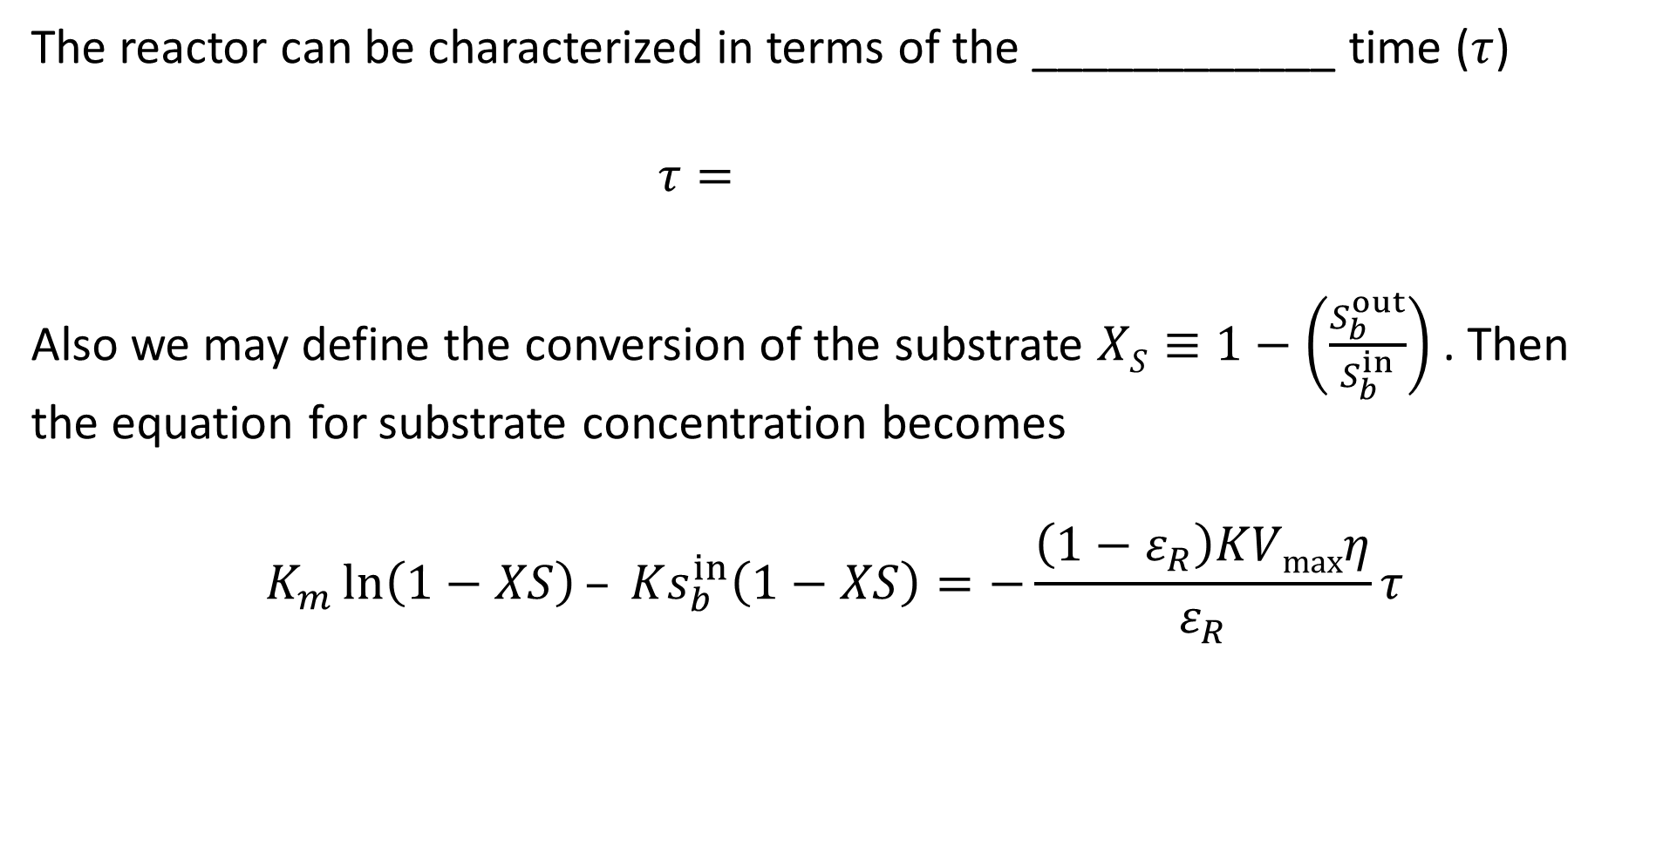
Packed Bed Reactor
The reactor can be characterized in terms of the ____________ time ($τ$)
$$τ=$$
Also we may define the conversion of the substrate $XS≡1−\left(\frac{S_{b}^{out}}{S_{b}^{in}}\right)$ . Then the equation for substrate concentration becomes
$$K_{m}\ln\left(1−XS\right)– Ks_{b}^{in}\left(1−XS\right)=−\frac{\left(1−ε_{R}\right)KVmaxη}{ε_{R}}τ$$
We saw this is class 1 with the CSTR (continuous stirred tank reactor)

Slide 22
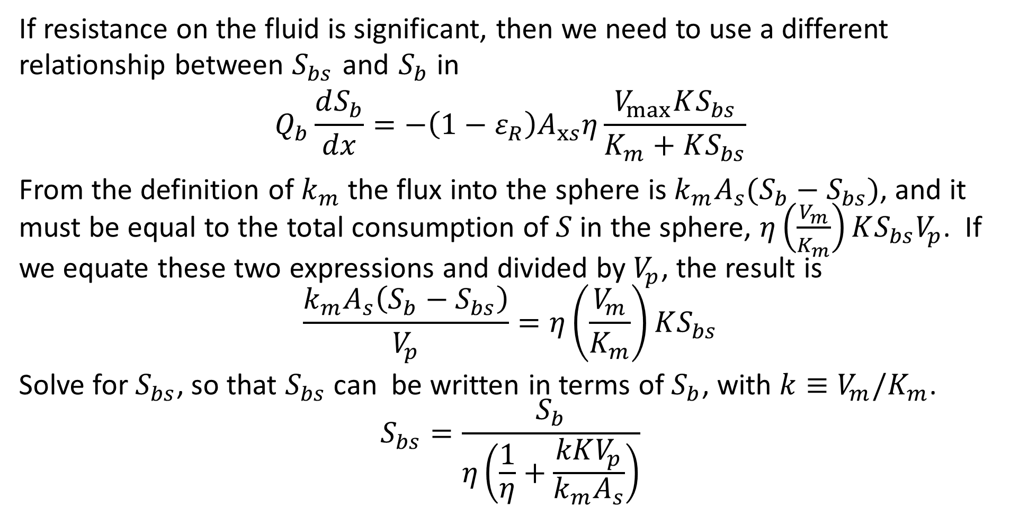
Packed Bed Reactor – Mass Transfer Dependent
If resistance on the fluid is significant, then we need to use a different relationship between $S_{bs}$ and $S_{b}$ in
$$Q_{b}\frac{dS_{b}}{dx}=−\left(1−ε_{R}\right)A_{xs}η\frac{V_{max}KS_{bs}}{K_{m}+KS_{bs}}$$
From the definition of $k_{m}$ the flux into the sphere is $k_{m}A_{s}(S_{b}−S_{bs})$, and it must be equal to the total consumption of $S$ in the sphere, $η\left(\frac{V_{m}}{K_{m}}\right)KS_{bs}V_{p}$. If we equate these two expressions and divided by $V_{p}$, the result is
$$\frac{k_{m}A_{s}\left(S_{b}−S_{bs}\right)}{V_{p}}=η\left(\frac{V_{m}}{K_{m}}\right)KS_{bs}$$
Solve for $S_{bs}$, so that $S_{bs}$ can be written in terms of $S_{b}$, with $k≡V_{m}/K_{m}$.
$$S_{bs}=\frac{S_{b}}{η\left(\frac{1}{η}+\frac{kKV_{p}}{k_{m}A_{s}}\right)}$$

Slide 23
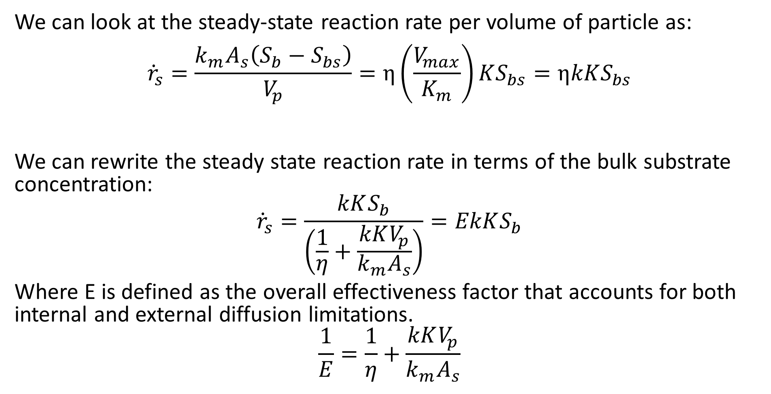
Overall Effectiveness
We can look at the steady-state reaction rate per volume of particle as:
$${\dot{r}}_{s}=\frac{k_{m}A_{s}\left(S_{b}−S_{bs}\right)}{V_{p}}=η\left(\frac{V_{max}}{K_{m}}\right)KS_{bs}=ηkKS_{bs}$$
We can rewrite the steady state reaction rate in terms of the bulk substrate concentration:
$${\dot{r}}_{s}=\frac{kKS_{b}}{\left(\frac{1}{η}+\frac{kKV_{p}}{k_{m}A_{s}}\right)}=EkKS_{b}$$
Where E is defined as the overall effectiveness factor that accounts for both internal and external diffusion limitations.
$$\frac{1}{E}=\frac{1}{η}+\frac{kKV_{p}}{k_{m}A_{s}}$$

Slide 24
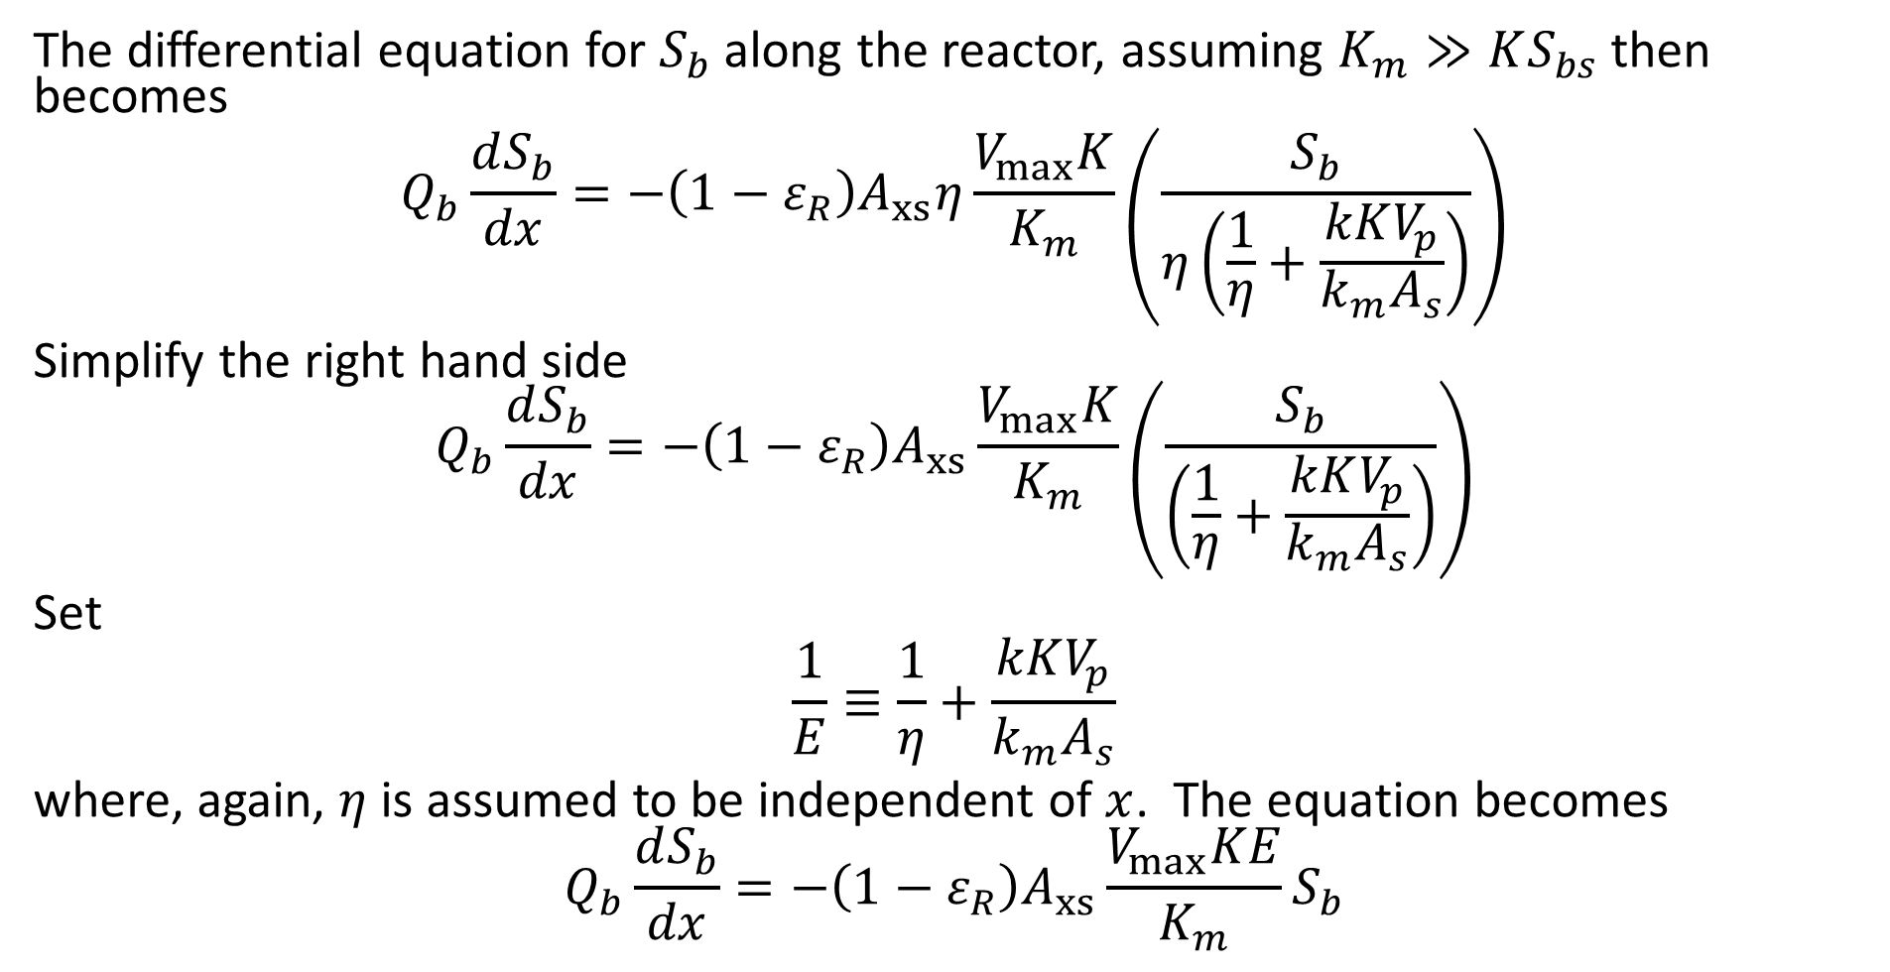
Packed Bed Reactor – Mass Transfer Dependent
The differential equation for $S_{b}$ along the reactor, assuming $K_{m}≫KS_{bs}$ then becomes
$$Q_{b}\frac{dS_{b}}{dx}=−\left(1−ε_{R}\right)A_{xs}η\frac{V_{max}K}{K_{m}}\left(\frac{S_{b}}{η\left(\frac{1}{η}+\frac{kKV_{p}}{k_{m}A_{s}}\right)}\right)$$
Simplify the right hand side
$$Q_{b}\frac{dS_{b}}{dx}=−\left(1−ε_{R}\right)A_{xs}\frac{V_{max}K}{K_{m}}\left(\frac{S_{b}}{\left(\frac{1}{η}+\frac{kKV_{p}}{k_{m}A_{s}}\right)}\right)$$
Set
$$\frac{1}{E}≡\frac{1}{η}+\frac{kKV_{p}}{k_{m}A_{s}}$$
where, again, $η$ is assumed to be independent of $x$. The equation becomes
$$Q_{b}\frac{dS_{b}}{dx}=−\left(1−ε_{R}\right)A_{xs}\frac{V_{max}KE}{K_{m}}S_{b}$$

Slide 25

Packed Bed Reactor – Mass Transfer Dependent
$$Q_{b}\frac{dS_{b}}{dx}=−\left(1−ε_{R}\right)A_{xs}\frac{V_{max}KE}{K_{m}}S_{b}$$
With boundary condition
$$S_{b}\left(x=0\right)=S_{b}^{in}$$
this equation readily integrates to
$$S_{b}\left(x\right)=S_{b}^{in}e^{− \frac{\left(1−ε_{R}\right)A_{xs}E\frac{V_{m}}{K_{m}}Kx}{Q_{b}}}$$

Slide 26
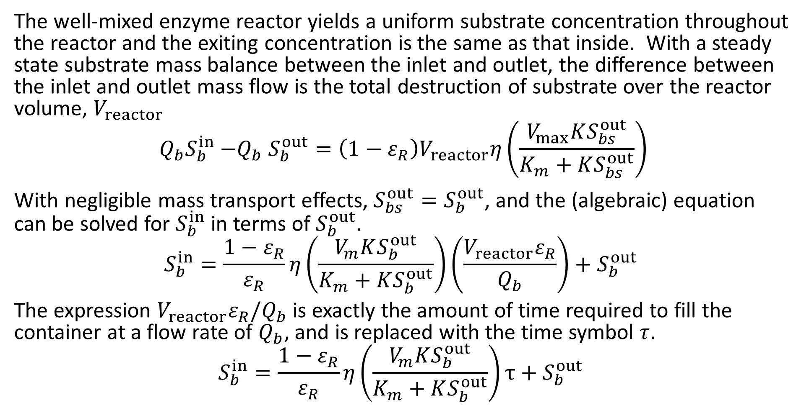
Well-Mixed Reactor
The well-mixed enzyme reactor yields a uniform substrate concentration throughout the reactor and the exiting concentration is the same as that inside. With a steady state substrate mass balance between the inlet and outlet, the difference between the inlet and outlet mass flow is the total destruction of substrate over the reactor volume, $V_{reactor}$
$$Q_{b}S_{b}^{in}{−Q}_{b}S_{b}^{out}=\left(1−ε_{R}\right)V_{reactor}η\left(\frac{V_{max}KS_{bs}^{out}}{K_{m}+KS_{bs}^{out}}\right)$$
With negligible mass transport effects, $S_{bs}^{out}=S_{b}^{out}$, and the (algebraic) equation can be solved for $S_{b}^{in}$ in terms of $S_{b}^{out}$.
$$S_{b}^{in}=\frac{1−ε_{R}}{ε_{R}}η\left(\frac{V_{m}KS_{b}^{out}}{K_{m}+KS_{b}^{out}}\right)\left(\frac{V_{reactor}ε_{R}}{Q_{b}}\right)+S_{b}^{out}$$
The expression $V_{reactor}ε_{R}/Q_{b}$ is exactly the amount of time required to fill the container at a flow rate of $Q_{b}$, and is replaced with the time symbol $τ$.
$$S_{b}^{in}=\frac{1−ε_{R}}{ε_{R}}η\left(\frac{V_{m}KS_{b}^{out}}{K_{m}+KS_{b}^{out}}\right)τ+S_{b}^{out}$$

Slide 27
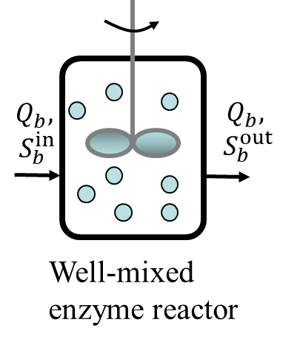
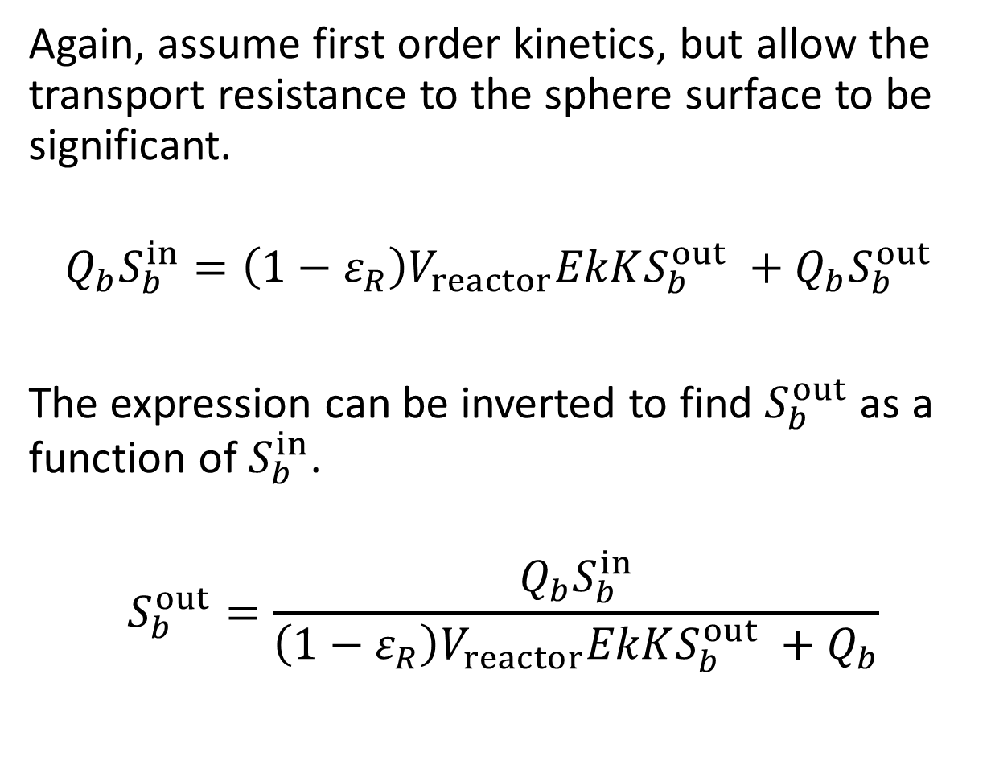
Well-Mixed Reactor – Mass Transfer Dependent
Again, assume first order kinetics, but allow the transport resistance to the sphere surface to be significant.
$$Q_{b}S_{b}^{in}=\left(1−ε_{R}\right)V_{reactor}EkKS_{b}^{out} +Q_{b}S_{b}^{out}$$
The expression can be inverted to find $S_{b}^{out}$ as a function of $S_{b}^{in}$.
$$S_{b}^{out}=\frac{Q_{b}S_{b}^{in}}{\left(1−ε_{R}\right)V_{reactor}EkKS_{b}^{out} +Q_{b}}$$

Slide 28
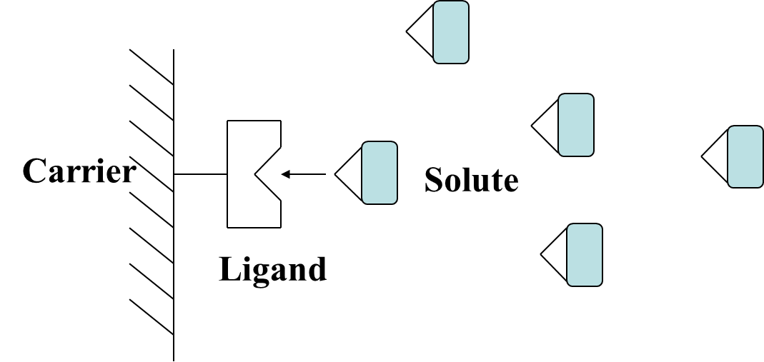
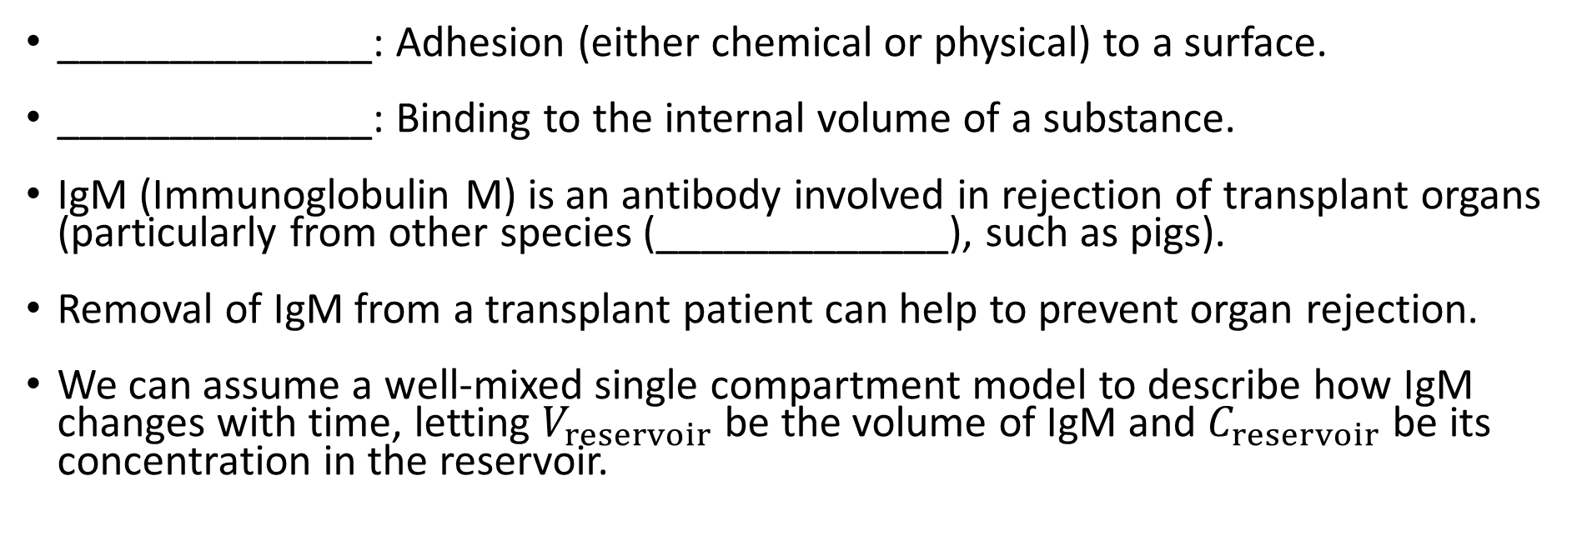
Affinity Adsorption
______________: Adhesion (either chemical or physical) to a surface.
______________: Binding to the internal volume of a substance.
IgM (Immunoglobulin M) is an antibody involved in rejection of transplant organs (particularly from other species (_____________), such as pigs).
Removal of IgM from a transplant patient can help to prevent organ rejection.
We can assume a well-mixed single compartment model to describe how IgM changes with time, letting $V_{reservoir}$ be the volume of IgM and $C_{reservoir}$ be its concentration in the reservoir.

Slide 29
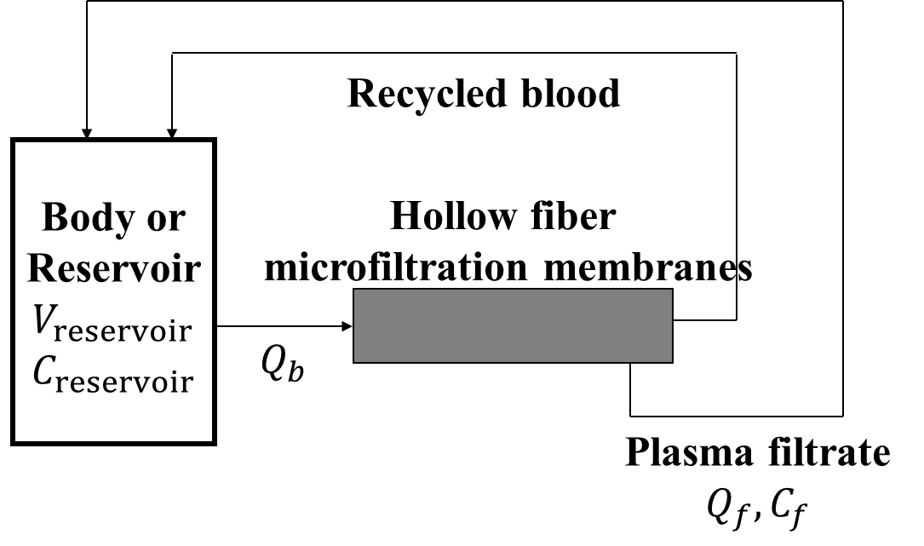

Affinity Adsorption
A mass balance on IgM is
$$V_{reservoir}\frac{dC_{reservoir}}{dt}=−Q_{f}\left(C_{reservoir}−C_{f}\right)$$
Where $C_{f}$ is the concentration of IgM in the filtrate. If all the IgM is bound to the ligand then $C_{f}=0$.

Slide 30
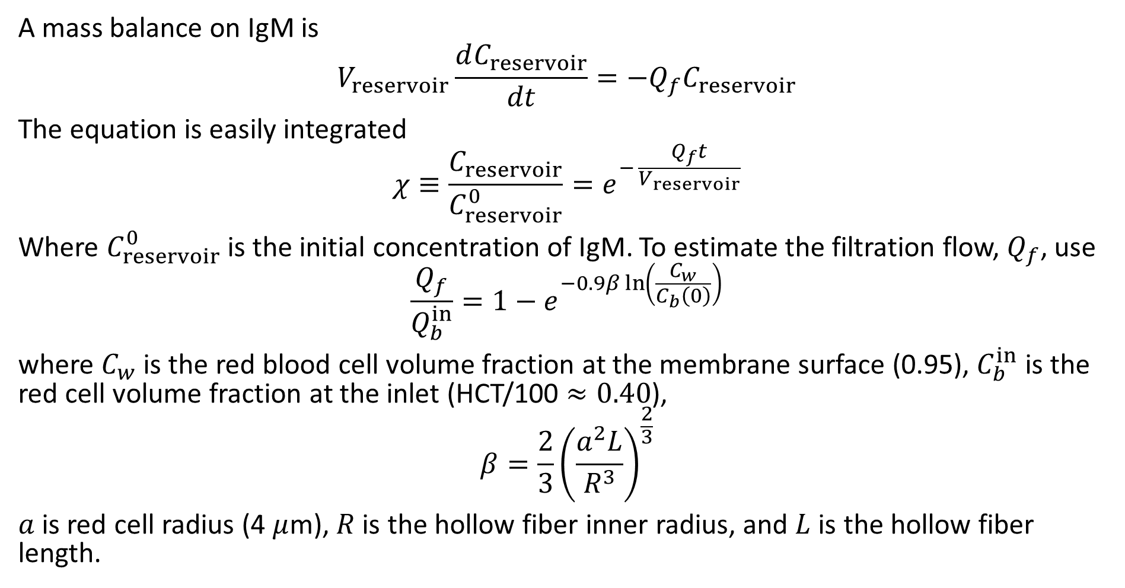
Affinity Adsorption
A mass balance on IgM is
$$V_{reservoir}\frac{dC_{reservoir}}{dt}=−Q_{f}C_{reservoir}$$
The equation is easily integrated
$$χ≡\frac{C_{reservoir}}{C_{reservoir}^{0}}=e^{− \frac{Q_{f}t}{V_{reservoir}}}$$
Where $C_{reservoir}^{0}$ is the initial concentration of IgM. To estimate the filtration flow, $Q_{f}$, use
$$\frac{Q_{f}}{Q_{b}^{in}}=1−e^{−0.9β\ln\left(\frac{C_{w}}{C_{b}\left(0\right)}\right)}$$
where $C_{w}$ is the red blood cell volume fraction at the membrane surface (0.95), $C_{b}^{in}$ is the red cell volume fraction at the inlet (HCT/100 $≈0.40$),
$$β=\frac{2}{3}{\left(\frac{a^{2}L}{R^{3}}\right)}^{\frac{2}{3}}$$
$a$ is red cell radius (4 $μ$m), $R$ is the hollow fiber inner radius, and $L$ is the hollow fiber length.

